Slide 1
Racial Inequities in Healthcare: Practical Solutions for Employers
Sanjay Prasad MD FACS
Jessica Brooks MPM PHR
Bruce Sherman MD FCCP FACOEM
Anticipated Book Launch: May 1, 2022
Sponsored by Race and Health Foundation
Notes:
Racial Disparities in Healthcare: Practical Solutions for Employers

Slide 2
Table of Contents
Foreword
Introduction
Implicit Bias
Allyship
Social Determinants of Health
Political Determinants of Health
Medical Mistrust
Racial Disparities in Behavioral/Mental Health
Racial Disparities in Primary Care
Racial Disparities in the Medical Referral Process
Racial Disparities in Surgery and Surgical Outcomes
Racial Disparities in Emergency Medicine
Diversity, Equity, and Inclusion (DEI) for Healthcare Practitioners
Environmental, Social, and Governance (ESG) Imperative
Benefits Plan Design
DEI: Measurement Approaches to Demonstrate Progress and Business Value
Conclusions
The Employer Perspective
Solution: Racial Disparities in Surgery and Surgical Outcomes
Health Equity and Pharmacy Benefit Managers (PBMs)

Slide 3
Writing Team
Sanjay Prasad MD FACS
George Washington University Hospital
Jessica Brooks MPM PHR
Pittsburgh Business Group on Health
Bruce Sherman MD FCCP FACOEM
UNC Greensboro
National Alliance of Healthcare Purchaser Coalitions
Triad HealthCare Network
Maiysha Clairborne MD
The Mind ReMapping Academy
Irene Dankwa-Mullan MD MPH
IBM Watson Health
Randa Deaton MA
Purchaser Business Group on Health
Lisa K. Fitzpatrick MD MPH
Grapevine Health
Bright Health
Zane Gates MD
PeopleOne Health
William Generett Jr. JD
Duquesne University
Lonie Haynes DL.P M.Sc. MPA ACHE
AmerisourceBergen
John Shufeldt MD JD MBA
Tribal EM
EMPower Emergency Physicians
Jill Wener MD
Conscious Anti-Racism LLC
Marissa Alert PhD
Johns Hopkins HealthCare Solutions
Karthik Ganesh EmpiRx Health
Notes:
Sanjay Prasad MD FACS, George Washington University Hospital
Jessica Brooks MPM PHR, Pittsburgh Business Group on Health
Bruce Sherman MD FCCP FACOEM, University of North Carolina Greensboro, National Alliance of Healthcare Purchaser Coalitions, Triad HealthCare Network
Marissa Alert PhD, Johns Hopkins HealthCare Solutions
Maiysha Clairborne MD, The Mind ReMapping Academy
Irene Dankwa-Mullan MD MPH, IBM Watson Health
Randa Deaton MA, Purchaser Business Group on Health
Lisa K. Fitzpatrick MD MPH, Grapevine Health, Bright Health
Karthik Ganesh, EmpiRx Health
Zane Gates MD, PeopleOne Health
William Generett Jr. JD, Duquesne University
Lonie Haynes DL.P M.Sc. MPA ACHE, AmerisourceBergen
John Shufeldt MD JD MBA, Tribal EM, EMPower Emergency Physicians
Jill Wener MD, Conscious Anti-Racism LLC

Slide 4
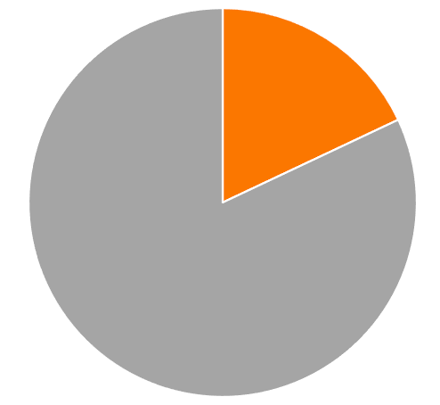
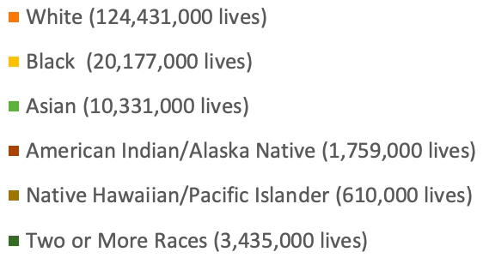
Audience: Employers
10.75 million employers in the US
Composition of US Labor Force
US Department of Labor
Notes:
money spent/cost of care

Slide 5
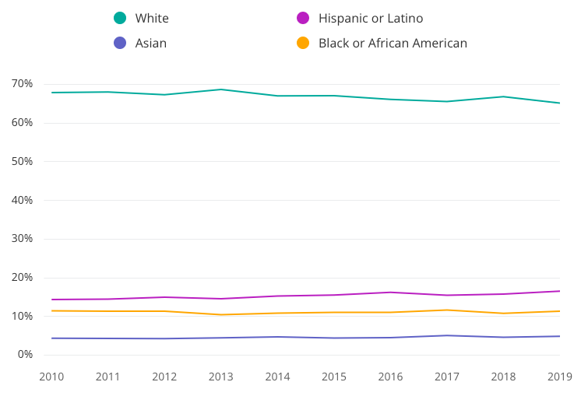
Audience: Employer Leadership
Leader Statistics By Race and Ethnicity
Zippia
Notes:
money spent/cost of care

Slide 6
Solving Racial Inequities in Healthcare
Arousing awareness about racial inequities in healthcare for Human Resource teams
Suggesting easily implemented solutions for benefit plan design
Empowering employers with health equity tools

Slide 7
Implicit Bias
Maiysha Clairborne MD
Jill Wener MD
Raise awareness of unconscious bias and provide solutions in the workplace.

Slide 8
Allyship
Recruit white individuals who believe in solving racial inequities to effect change.
Jill Wener MD

Slide 9
Social Determinants of Health
Lisa K. Fitzpatrick MD MPH
The goal should be to understand SDOH —and then build support to make the workplace a positive catalyst for health.

Slide 10
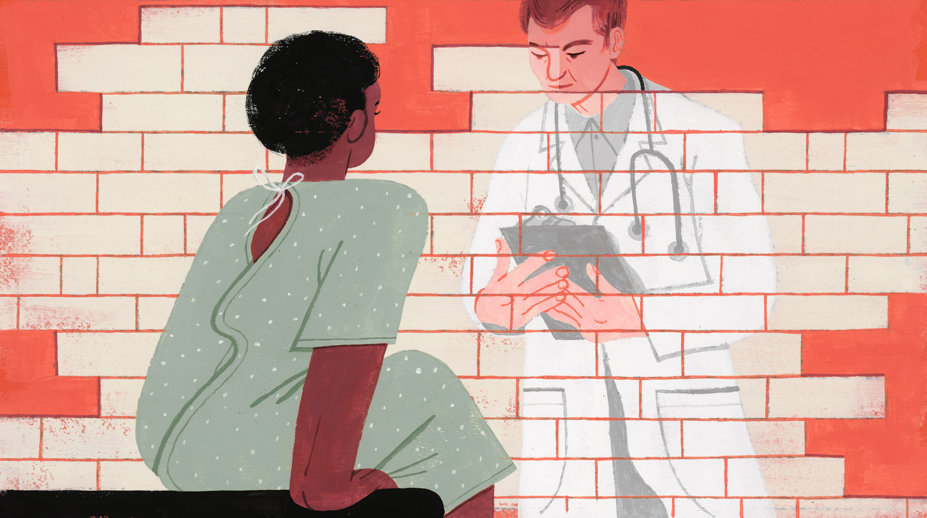
Medical Mistrust
Lisa K. Fitzpatrick MD MPH
Create a plan to regain the trust of black employees seeking care.

Slide 11
Racial Disparities in Behavioral and Mental Health
Marissa Alert PhD
Offer benefit solutions to improve access to behavioral and mental health specialists.
Notes:
Creating a mentally healthy work environment for all employees can help prevent burnout.
Modifying benefit design to improve access to behavioral and mental health specialists.

Slide 12
Racial Disparities in Surgery and Surgical Outcomes
Sanjay Prasad MD FACS
Black patients suffer worse surgical outcomes than white patients, even in studies that control for confounding factors.
SurgiQuality provides a competitive landscape where best in-class surgeons compete to care for black patients.

Slide 13
Environmental, Social, and Governance (ESG) Imperative
Irene Dankwa-Mullan MD MPH
Solving for racial inequities satisfies the ESG imperative.

Slide 14
Benefit Plan Design
Bruce Sherman MD FCCP FACOEM
Irene Dankwa-Mullan MD MPH
Employers and plan sponsors must identify and address unmet health and well-being priorities among racialized groups and low-income workers.

Slide 15
DEI: Measurement Approaches to Demonstrate Progress and Business Value
Bruce Sherman MD FCCP FACOEM
Irene Dankwa-Mullan MD MPH
A thoughtful, systematic approach to evaluation of health equity improvement efforts can serve to demonstrate their effectiveness — and the impact of improved worker health on business operations.

Slide 16
“Of all the forms of inequality, injustice in healthcare is the most shocking and inhumane.”
- Dr. Martin Luther King, Jr.

