Slide 1
Race Forward: The Health Equity Guide for Employers
Sanjay Prasad MD FACS
Jessica Brooks MPM PHR
Bruce Sherman MD FCCP FACOEM
Now Available
Notes:
Racial Disparities in Healthcare: Practical Solutions for Employers

Slide 2
Table of Contents
Foreword
Introduction
Implicit Bias
How to Be An Ally
Social Determinants of Health
Disparities in Mental Health Care
Race and Surgical Outcomes
Racial Disparities in Emergency Medicine
Equitable Health Benefit Design
Using DEI Measures to Track Impact
Conclusions
Employers’ Role in Advancing Racial Health Equity
Health Equity and Pharmacy Benefit Managers (PBMs)
Medical Mistrust
Environment Social Governance Metrics and Health Equity
Primary Care: A Key Lever to Advance Health Equity
Business Case for Employer Investments in Workforce Health Equity
Workplace Determinants of Health
Taking Action on Employee Social Determinants of Health
Evolution of Disparities in Primary Care
Employer Strategy to Solve Surgical Inequities

Slide 3
Sanjay Prasad MD FACS
SurgiQuality GW University Hospital
Bruce Sherman MD FCCP FACOEM
UNC Greensboro
Triad HealthCare Network
Maiysha Clairborne MD
The Mind ReMapping Academy
Irene Dankwa-Mullan MD MPH
Merative
Randa Deaton MA
Purchaser Business Group on Health
Lisa K. Fitzpatrick MD MPH
Grapevine Health
GW University Milken Institute
Zane Gates MD
PeopleOne Health
Megan Douglas
National Center for Primary Care
Morehouse School of Medicine
Larry McNeely MPA
Primary Care Collaborative
John Shufeldt MD JD MBA
Tribal EM
EMPower Emergency Physicians
Jill Wener MD
Conscious Anti-Racism LLC
Marissa Alert PhD
Johns Hopkins HealthCare Solutions
Karthik Ganesh EmpiRx Health
Ann Greiner Primary Care Collaborative
Mary Jane Osmick MD
American Specialty Health
Population Health Alliance
Noah Westfall
Primary Care Collaborative
Anne Gaglioti MD MS
National Center for Primary Care
Morehouse School of Medicine
Emily Stiehl
University of Illinois Chicago
Dominic Mack MD MBA
Morehouse School of Medicine
Jessica Brooks MPM PHR
Pittsburgh Business Group on Health
Notes:
Sanjay Prasad MD FACS, George Washington University Hospital
Jessica Brooks MPM PHR, Pittsburgh Business Group on Health
Bruce Sherman MD FCCP FACOEM, University of North Carolina Greensboro, National Alliance of Healthcare Purchaser Coalitions, Triad HealthCare Network
Marissa Alert PhD, Johns Hopkins HealthCare Solutions
Maiysha Clairborne MD, The Mind ReMapping Academy
Irene Dankwa-Mullan MD MPH, IBM Watson Health
Randa Deaton MA, Purchaser Business Group on Health
Lisa K. Fitzpatrick MD MPH, Grapevine Health, Bright Health
Karthik Ganesh, EmpiRx Health
Zane Gates MD, PeopleOne Health
William Generett Jr. JD, Duquesne University
Lonie Haynes DL.P M.Sc. MPA ACHE, AmerisourceBergen
Mary Jane Osmick MD, American Specialty Health, Population Health Alliance
John Shufeldt MD JD MBA, Tribal EM, EMPower Emergency Physicians
Jill Wener MD, Conscious Anti-Racism LLC

Slide 4
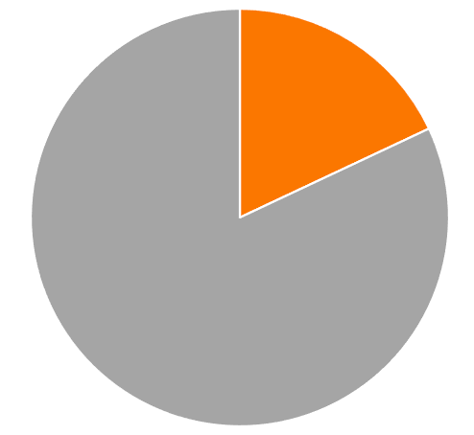
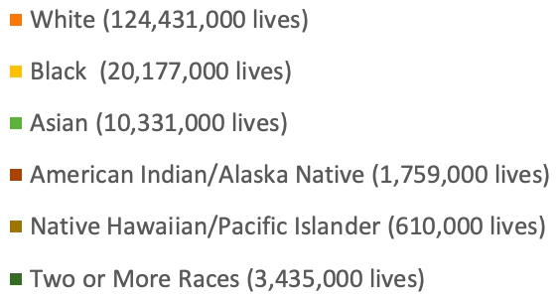
Audience: Employers
10.75 million employers in the US
Composition of US Labor Force
US Department of Labor
Notes:
money spent/cost of care

Slide 5
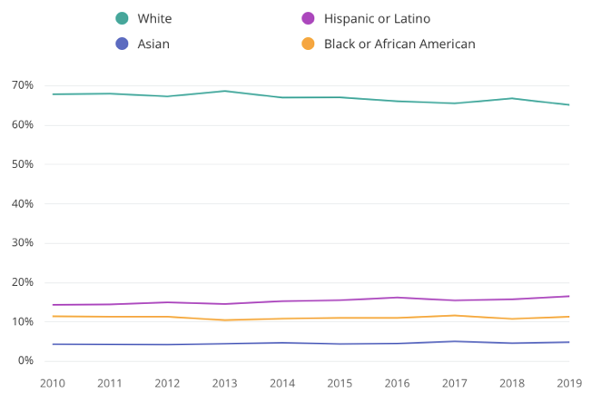
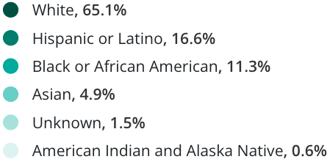
Audience: Employer Leadership
Leader Statistics By Race and Ethnicity
Zippia
Notes:
money spent/cost of care

Slide 6
Solving Racial Inequities in Healthcare
Arousing awareness about racial inequities in healthcare for Human Resource teams
Suggesting easily implemented solutions for benefit plan design
Empowering employers with health equity tools

Slide 7
Implicit Bias
Maiysha Clairborne MD
Jill Wener MD
Raise awareness of unconscious bias and provide solutions in the workplace.

Slide 8
Allyship: How to be an Ally
Recruit white individuals who believe in solving racial inequities to effect change.
Jill Wener MD

Slide 9
Taking Action on Employee Social Determinants of Health
Mary Jane Osmick MD
The goal should be to understand SDOH —and then build support to make the workplace a positive catalyst for health.

Slide 10
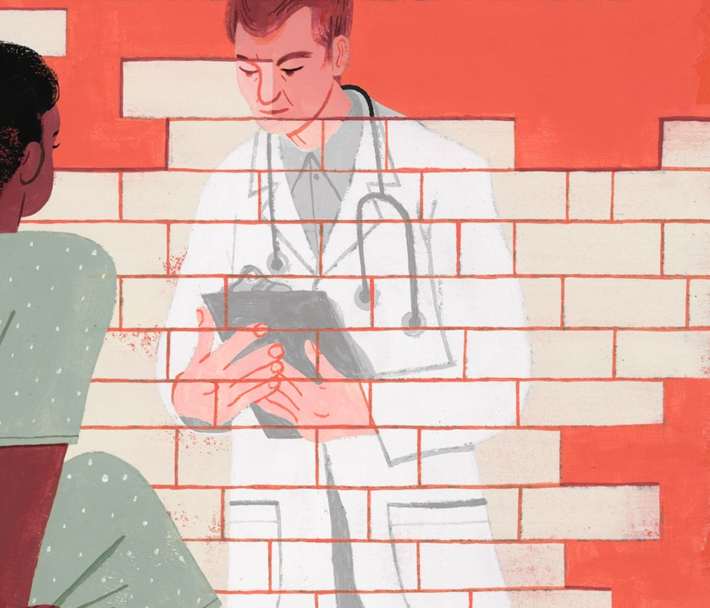
Medical Mistrust
Lisa K. Fitzpatrick MD MPH
Create a plan to regain the trust of black employees seeking care.

Slide 11
Primary Care: A Key Lever to Advance Health Equity
Ann Greiner
Improving access to primary care overall and specific primary care-based interventions can shift outcomes for employees experiencing health inequities.

Slide 12
Racial and Ethnic Disparities in Mental Health Care
Marissa Alert PhD
Offer benefit solutions to improve access to behavioral and mental health specialists.
Notes:
Creating a mentally healthy work environment for all employees can help prevent burnout.
Modifying benefit design to improve access to behavioral and mental health specialists.

Slide 13
Race and Surgical Outcomes
Sanjay Prasad MD FACS
Black patients suffer worse surgical outcomes than white patients, even in studies that control for social determinants.
SurgiQuality provides a competitive landscape where best in-class surgeons, blinded to name, race and ethnicity, compete to care for black patients.

Slide 14
Environment Social Governance Metrics and Health Equity
Irene Dankwa-Mullan MD MPH
Solving for racial inequities satisfies the ESG imperative.

Slide 15
Equitable Health Benefit Design
Bruce Sherman MD FCCP FACOEM
Irene Dankwa-Mullan MD MPH
Employers and plan sponsors must identify and address unmet health and well-being priorities among racialized groups and low-income workers.

Slide 16
Using DEI Measures to Track Impact
Bruce Sherman MD FCCP FACOEM
Irene Dankwa-Mullan MD MPH
A thoughtful, systematic approach to evaluation of health equity improvement efforts can serve to demonstrate their effectiveness — and the impact of improved worker health on business operations.

Slide 17
“Of all the forms of inequality, injustice in healthcare is the most shocking and inhumane.”
- Dr. Martin Luther King, Jr.

